Slide 1
E-COMMERCE WEBSITE Development

Slide 2

About Us
Our platform provides you with anything you want, on rent. We are more likely to focus on furniture and clothes. We provide you with anything you want on rent for one day or one year, as per your requirements at a reasonable rate.

Slide 3
Problem
Customers
Market gap
Products are available on rent, but lack of stores and inconvenient services of business
Few, if any, products on the market help customers like we do​

Slide 4




Solution
Close the gap
Target audience
Cost savings
Easy to use
Our product makes consumer lives easier, and no other product on the market offers the same features​
Gen Z (18-25 years old)
Reduce expenses for replacement products
Simple design that gives customers the targeted information they need​

Slide 5
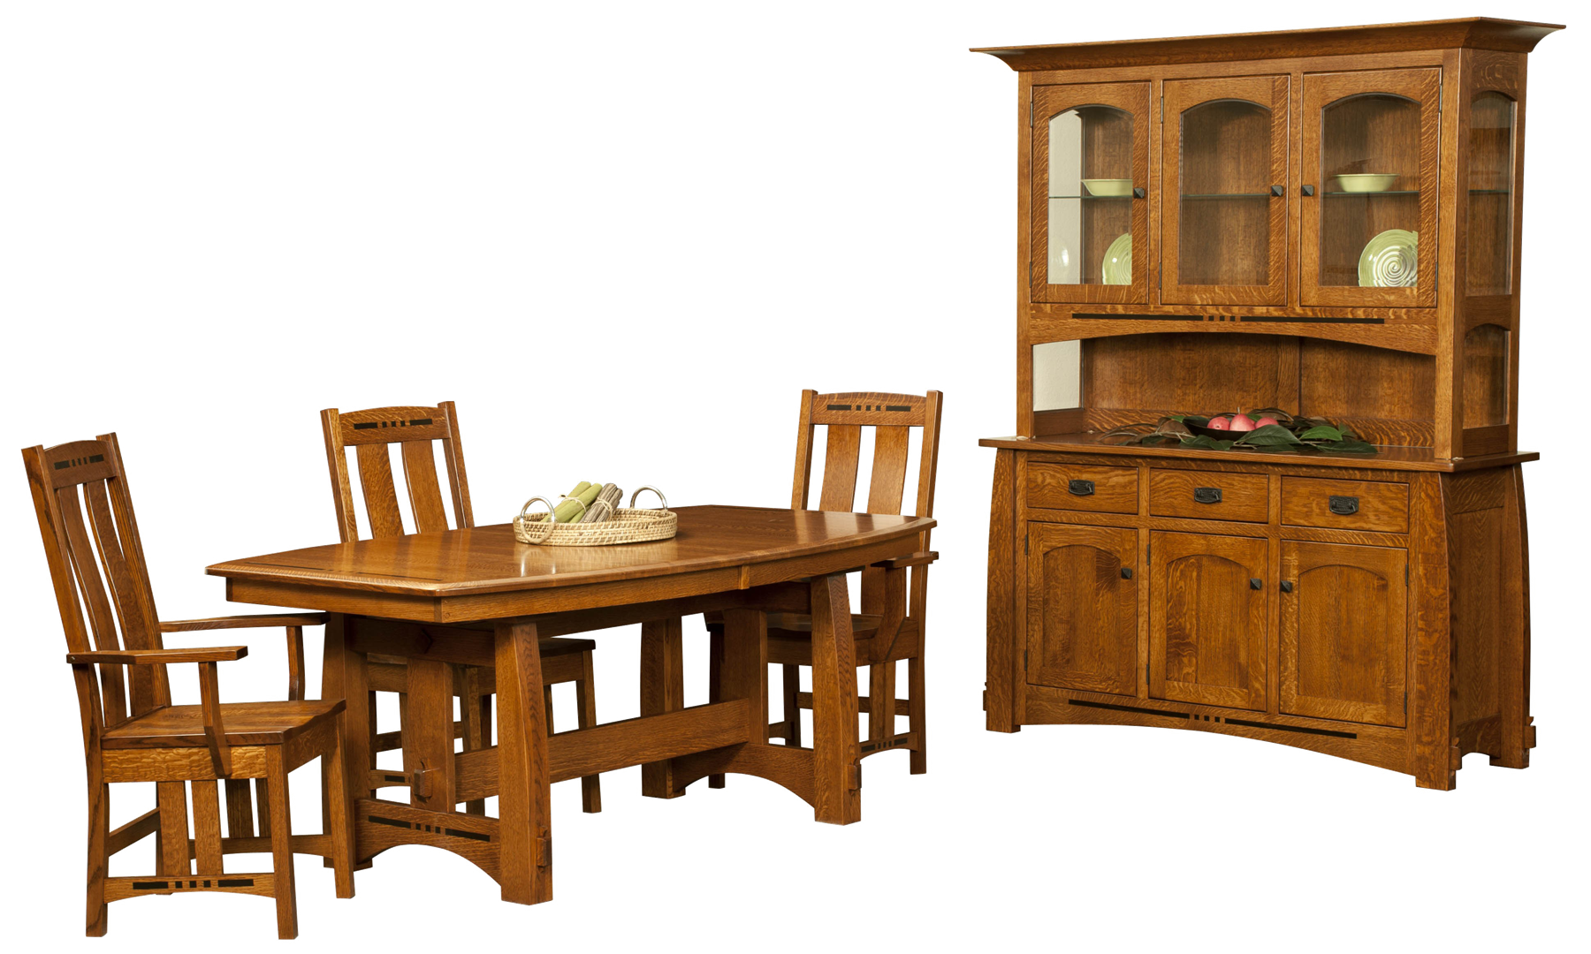



What we do?🤔
We provide you anything for rent, for eg:
This Photo by Unknown Author is licensed under CC BY-NC

Slide 6



Product Overview
Unique
First to market
Only product specifically dedicated to this niche market
First beautifully designed product that's both stylish and functional​
Tested
Authentic
Conducted testing with college students in the area​
Designed with the help and input of experts in the field ​

Slide 7



Pricing scheme
100
1000₹
🔘
10

Slide 8




Our team
Shivam shedge
Hardik sonawne​
Shubham rane​
Vishal singh​​

Slide 9
Thank you
Shubham Rane
+91 8655550598
rshubham21comp@student.mes.ac.in
www.rentz.com​

